Slide 1
Psychological resilience in man’s search for meaning
1740201, 10, 14, 19, 24, 29, 34, 40, 56 Slot 6

Slide 2

Introduction

Slide 3
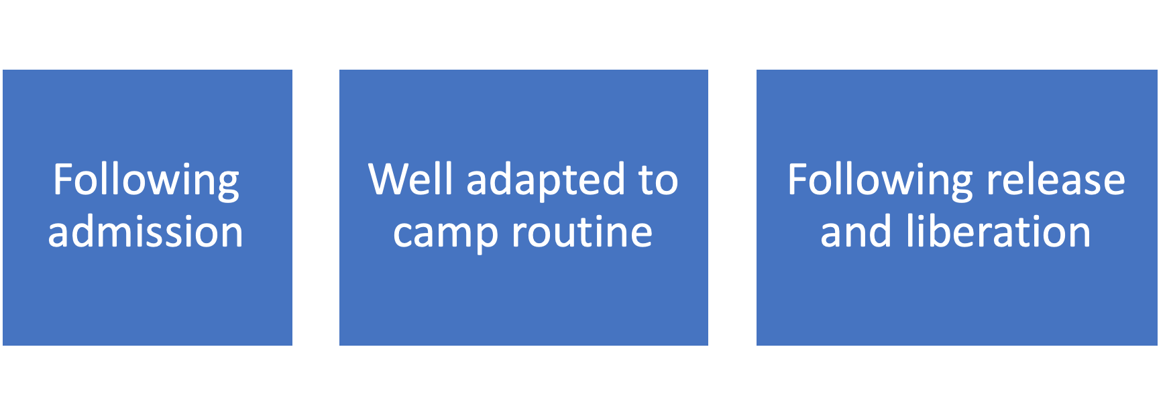
Inmate’s Reactions to Camp life

Slide 4
Portrayal in the novel
“Just waited for things to take their course”
“We had nothing to lose except our so ridiculously naked lives”.
“A man can get used to anything but do not ask us how.”
Even the gas chambers lost their horror after the first few days.

Slide 5
Portrayal in the novel
“Blunting of emotions and feeling that one could not care anymore..”
Necessary mechanism of self defense.
Instances from the novel
The suffering of the 12-year old boy in the frost biting cold
The death of the typhus patient in the hut

Slide 6
Portrayal in the novel
“WHEN WE ARE NO LONGER ABLE TO CHANGE A SITUATION, WE ARE CHALLENGED TO CHANGE OURSELVES”
“THOSE WHO HAVE A ‘WHY’ TO LIVE, CAN BEAR WITH ALMOST ANY ‘HOW’.
- VIKTOR FRANKL

Slide 7
Portrayal in the novel
EXAMPLES FROM THE TEXT
HAVING DINNER TOGETHER.
STEALING BREAD.
SAVING OTHERS.

Slide 8
Loss of psychological Resilience
. People lost their hope in the camp.
. Viktor Frankl said, they can take everything from a prisoner, except one thing: “The last of the human freedoms, to choose one's attitude in any given set of circumstances, to choose one.”
. Quote by Viktor Frankl
“In psychiatry, there is a certain condition known as the delusion of reprieve. The condemned man, immediately before his execution, gets the illusion that he might be reprieved at the very last minute. No one could yet grasp the fact that everything would be taken away. all we possessed, literally, was our naked existence.”

Slide 9
What were the outcomes?
A study was conducted in Mykolas Romeris University, Institute of Psychology
Four female and six male survivors were included in the survey.
Among the major resilience, factors identified were social support

Slide 10
1. Social Support
1.1 Help Received from Close Relatives
1.2 Help Received from Other People
In the narratives presented in this study, the social support reported by survivors was an important external protective factor which helped overcome trauma and stimulated posttraumatic growth during and after the Holocaust.

Slide 11
2. Changes in Values
2.1 Changes in Attitude towards People
2.2 Changes in Attitude towards Life
2.3 Changes in Attitude towards God
It demonstrate changed attitudes towards people and life by Holocaust survivors. These findings are consistent with the concept of post-traumatic growth.
The results of the study include changed attitudes towards God, although these changes were both positive and negative.

Slide 12
3. Integration of Experience
3.1 Acceptance of Fate
"Everybody has their own destiny, I had mine. One needs to be joyful that one survived and had an opportunity to live." (Jakov)
3.2 Sharing Experiences with Others
"I’ve written three books. I tell my story, but they don’t understand. They weren’t there." (Aron)
The study found integration of experience through acceptance of fate and sharing experiences with others were important factors in survival.

Slide 13
4. Self-Reliance
The results include self-reliance by survivors, which is defined as a defensive construct which compels problem-solving and provides a sense of control when personal control is at its lowest.
They found survivors emphasized the situation was understandable and manageable even under extremely adverse conditions.

Slide 14
Role of Indignity
Usually led to the loss of Psychological Resilience
“Sinister meaning behind the movement of a man’s finger”
Reduced to a Number
“mental agony caused by the injustice” and not physical pain
Referred to as ‘pigs’ or ‘beast’
“A creature with which you have so little common that you do not even punish it.”
“There are moments when indignation can rouse even a seemingly hardened prisoner - ‘indignation’ not about cruelty or pain, but about the insult connected with it.”

Slide 15
Role of Indignity (cont.)
Inferiority Complex - “average prisoner felt himself utterly degraded”
Inner Hold - decided the sort of person and not the camp’s influences
“Spiritual Freedom cannot be taken away”
“In the bitter fight for self - preservation he may forget his human dignity and become no more than an animal”

Slide 16
Role of Indignity (cont.)
Blurring of lines between Psychological Resilience and Indignity.
“He simply gave up. There he remained, lying in his own excreta, and nothing bothered him anymore.”
“The prisoner who had lost faith in the future - his future - was doomed”
1945 - March 30th
Christmas 1944

Slide 17
The Negative Aspect Of
Psychological Resilience

Slide 18
Nihilism
The rejection of all religious and moral principles, in the belief that life is meaningless
The belief that nothing in the world has a real existence
“I'm a nihilist. I don't believe in anything, not even nihilism.”
—Johnny Black, The Anarchist Cookbook

Slide 19
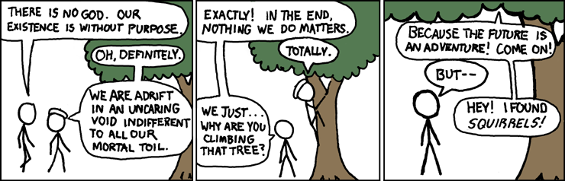

Slide 20
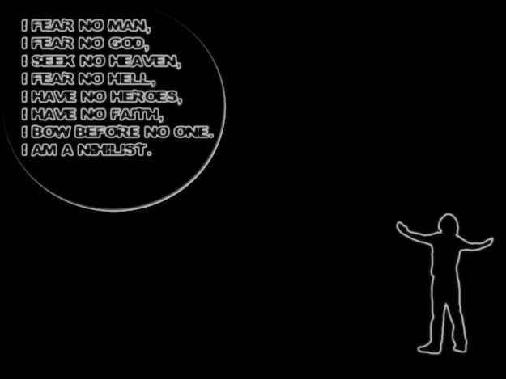

Slide 21
•The best way to develop resilience is through hardship
•False hope syndrome
•Sticking to “bad” jobs
•
•
•
•
•“ Overused strengths become weaknesses”
-Rob Keiser

Slide 22
Coping Mechanisms
•Artificially inflated egos
•Moves away from groups, put up walls to avoid being criticized and openly admit faults as a way to guard against public shaming
•Takes one to know one
•Evolve or Die
•Being Human??

Slide 23
Benefits Of psychological Resilience

Slide 24
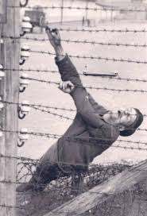
Suicide Attempts:
> Hopelessness.
> No sign of freedom.
> Torture.
> Depersonalization.
> Worthlessness of psychotherapeutic and psychohygienic efforts.

Slide 25
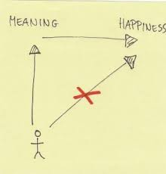
Positive Psychology
> “Emotion, which is suffering, ceases to be suffering as soon as we form a clear and precise picture of it.”
> Who knows “Why” for his existence,
will bear almost any“how”.
> Restoration.

Slide 26
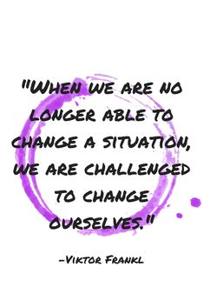

Slide 27
CONCLUSION
Denied basic needs, no hope, no identity
Nakedness of their indignity was more stark than the nakedness of their bodies.
Coping solutions Victor F’s 2 theories -
PsychoTherapy
LogoTherapy - existential analysis

Slide 28
PSYCHOTHERAPY + LOGOTHERAPY
Life has meaning - “Just waited for things to take their course”
Our will to find meaning
We have the freedom to make meaning out of it
Through the novel - Freedom through work
Freedom, will, meaning, attitude in suffering, happiness through work.

Slide 29
SUMMARY
Introduction - Prakhar(14)
Topics Portrayed In the novel - Anushka(24), Sahasra(34)
Loss due to Psychological resilience - Geethika(40)
Outcomes of the psychological resilience - Adarsh(01)
Indignity leading to the Psychological resilience - Mayuri(29)
Negative aspects of Psychological resilience - Gokul(10)
Benefits of Psychological resilience - Vaibhav(19)
Solution/Conclusion & Wrap up - Jeevan(56)

Slide 30
“Was mich nicht umbringt macht mich starker”
“That which does not kill me, makes me stronger.”
-Nietzsche

